Slide 1

August 2020
US Digital Display Advertising 2020: A Guide to eMarketer’s Complete Forecast
Nicole Perrin
Principal Analyst

Slide 2
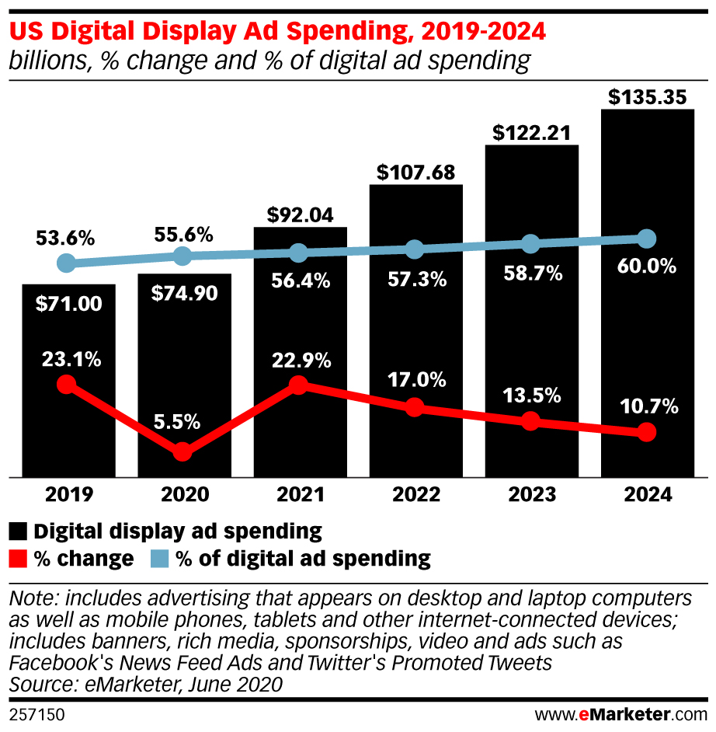
Display spending will rise by 5.5% this year, despite the pandemic and recession
This is a major downward revision from our previous forecast, but display is still growing as search spending declines.
Note that we define “display” broadly to include all digital video ads.

Slide 3
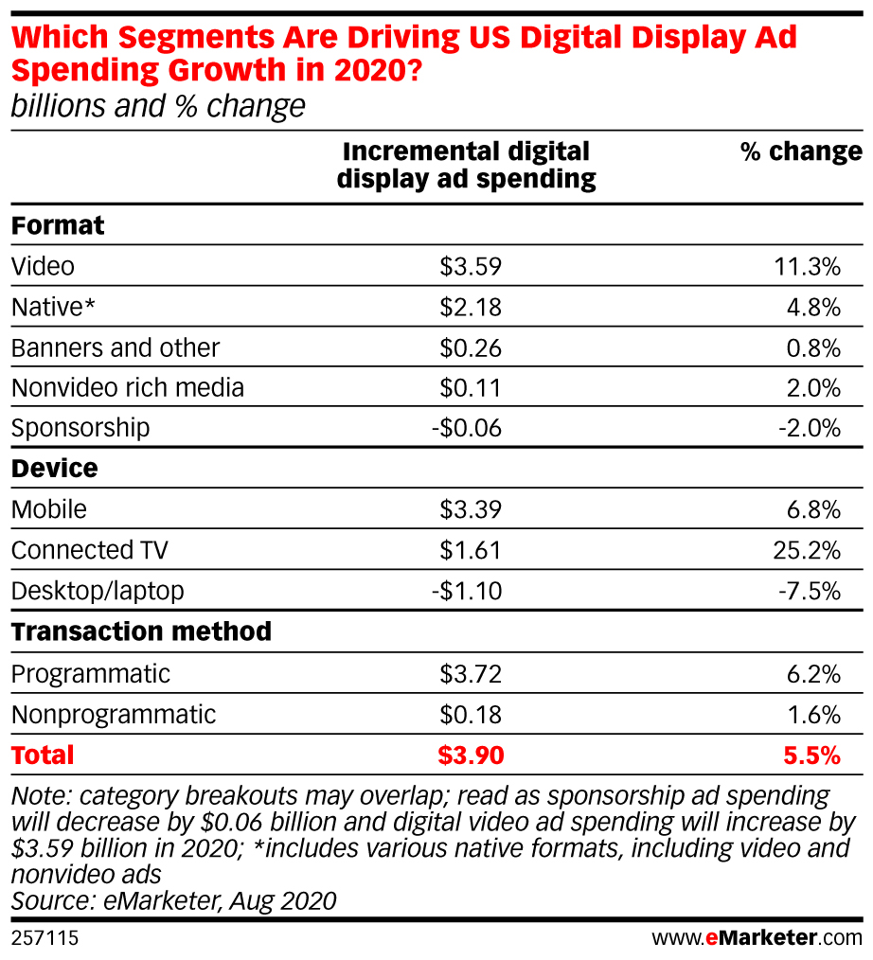
Video is the biggest driver of growth in display ad spending this year
Mobile, CTV, native formats and programmatic transactions are also driving increases.

Slide 4
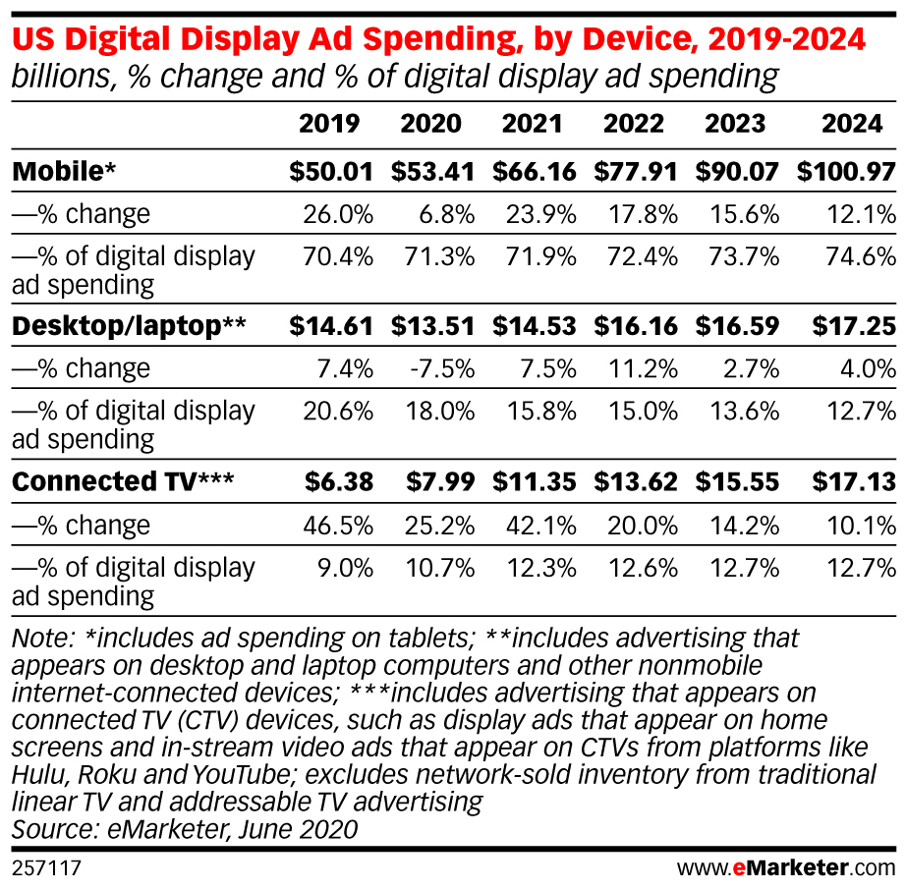
More than seven in 10 display ad dollars go to placements on mobile devices
The share of spending going to desktop/laptop screens is dwindling, as CTV ad spending gains ground.
CTV has a larger share of the pie within digital video advertising specifically.

Slide 5
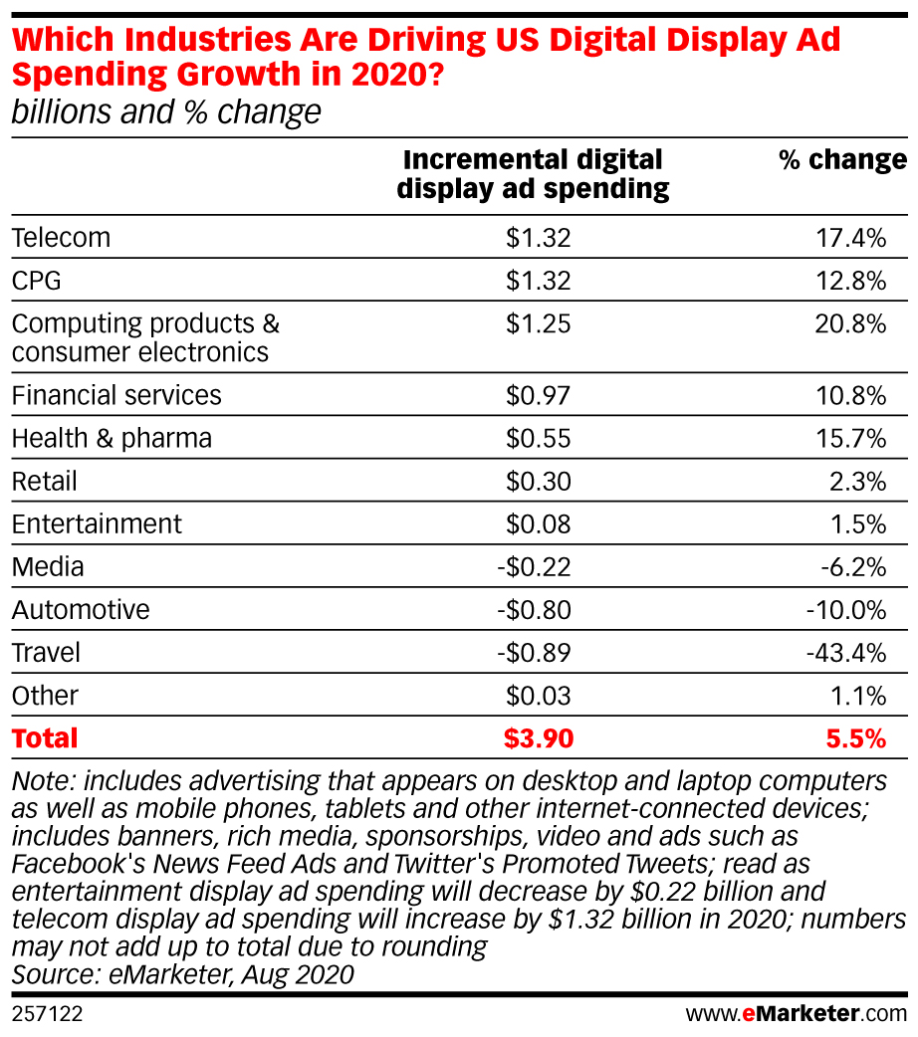
Telecom, CPG and consumer electronics advertisers will increase their display spending by more than $1 billion this year.

Slide 6
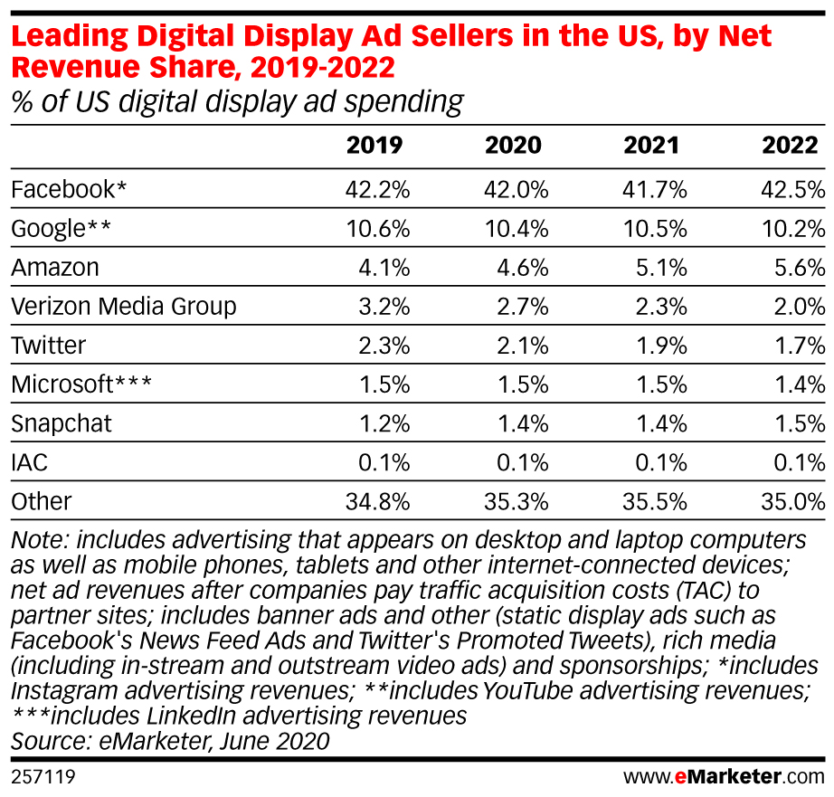
Facebook earns the largest share of display ad spending in the US
No. 2 Google isn’t particularly close in terms of net display revenues—but if you take Google’s gross revenues into account, it takes in more than 25% of display ad spending.

Slide 7
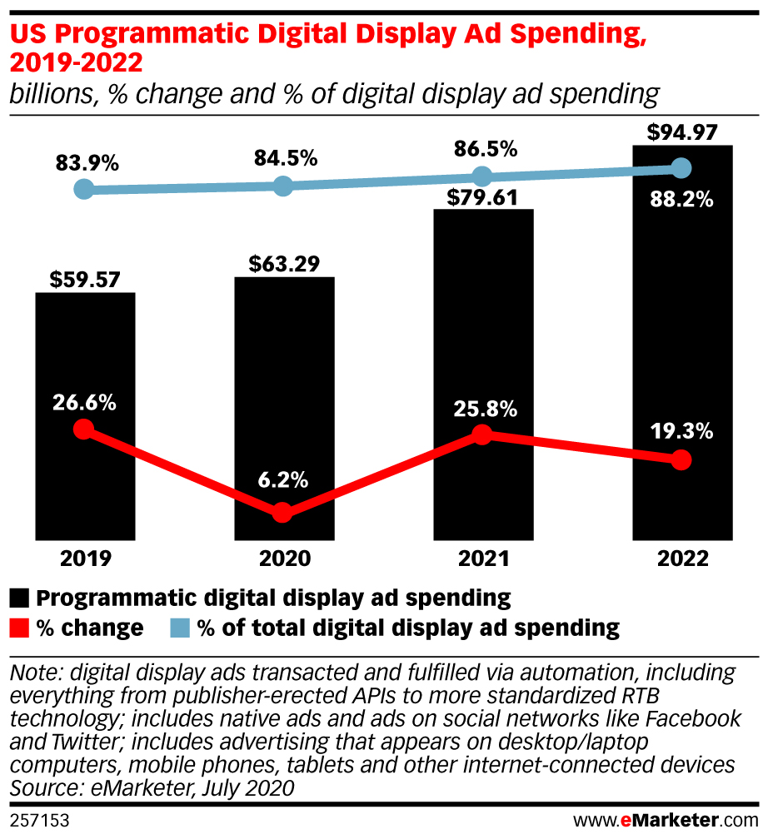
Almost 85% of display spending in the US will be transacted through automated means this year
Programmatic trading has dominated display advertising for years and continues to gain share.
Growth in programmatic will be above the average for display this year, and it will bounce back to 25.8% in 2021.

Slide 8
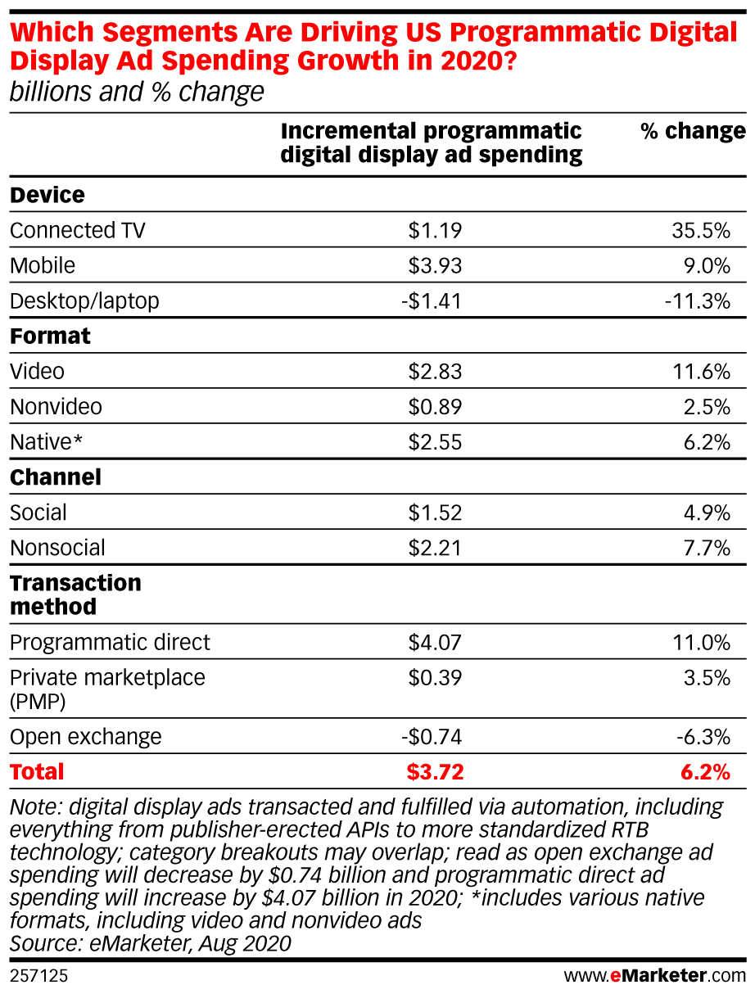
This year’s growth is being driven by mobile, CTV, video and native, and most will involve programmatic direct transactions.

Slide 9
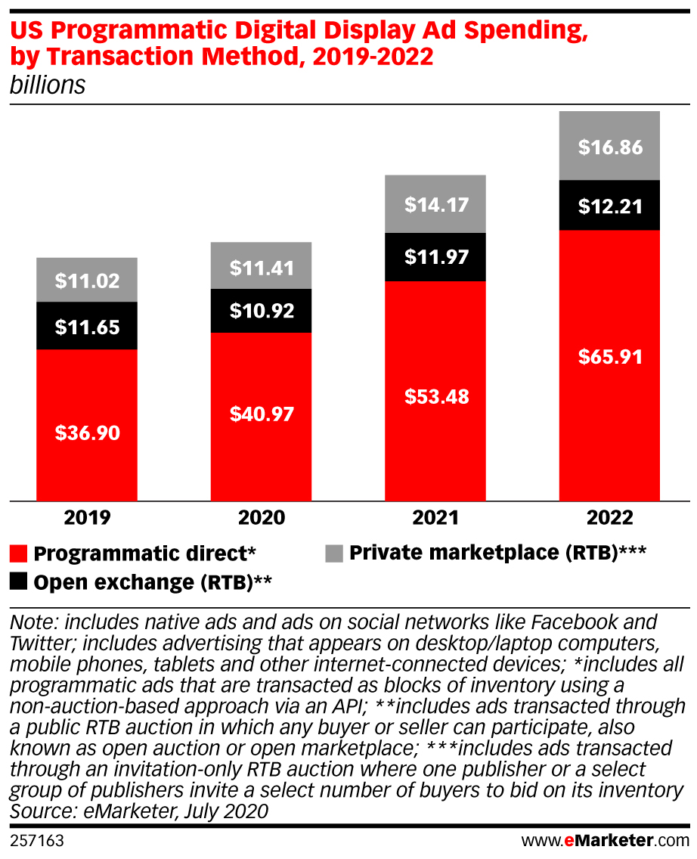
Direct transactions dominate programmatic display spending
The share of direct transactions is higher on mobile, where almost all Facebook advertising is concentrated.
Elsewhere, the order of precedence is the same, but it’s a more even split between transaction types.

Slide 10
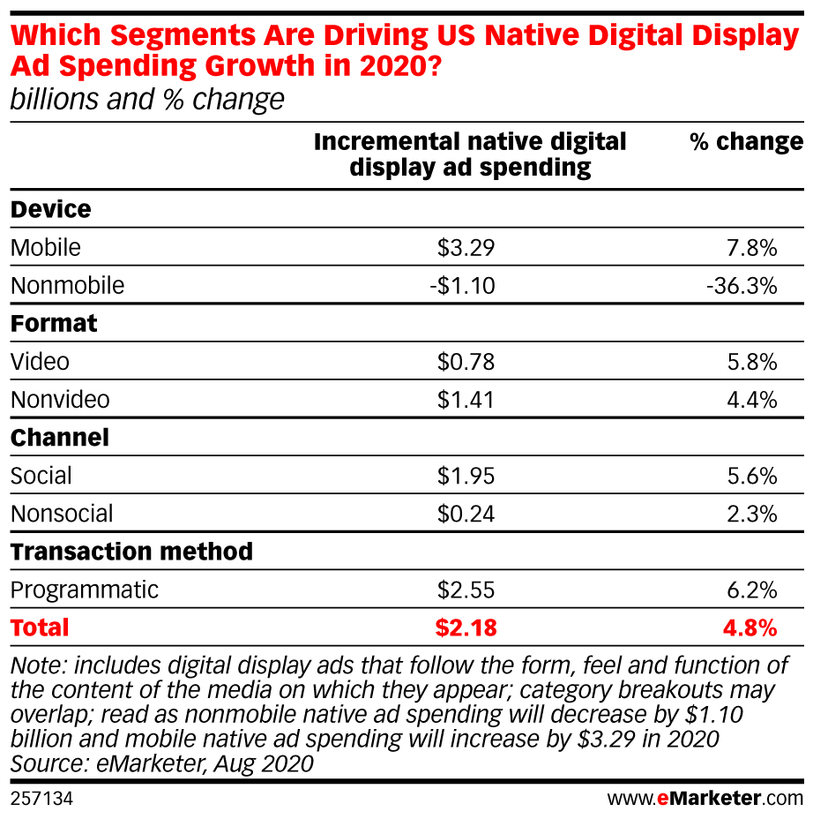
Native display ad spending will grow this year, but slower than overall display
Native video (i.e., outstream video) was hit by a pullback of brand advertiser spending early in the pandemic.
Meanwhile, as more CTV inventory comes online programmatically, more video spending is flowing to in-stream.

Slide 11
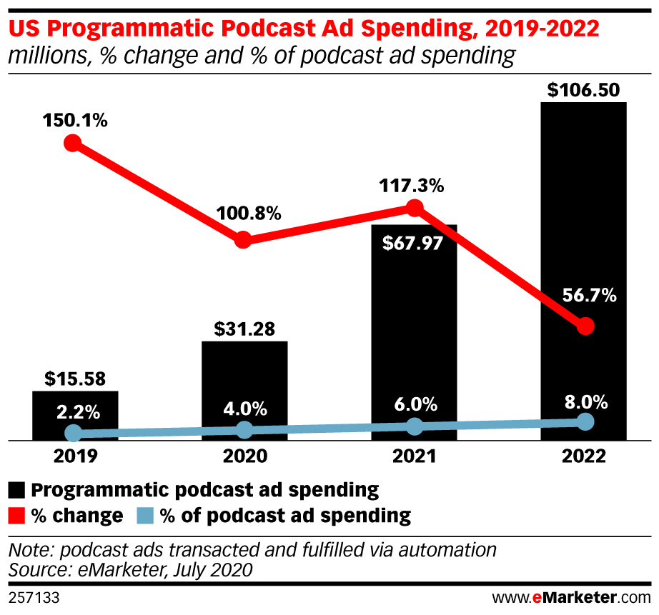
Digital radio ad spending will plunge this year, but with some (small) bright spots
Programmatic is a small slice of digital radio, but it’s growing.
Podcast ads are an even smaller slice—but they’re also growing, including a doubling of programmatic spending.

Slide 12
Key Takeaways
Most of this forecast is driven by the effects of the pandemic and related economic fallout.
Further updates will look to Q2 results at major ad sellers, along with macroeconomic conditions in the US. We’re also paying attention to trade relations with China and changes to Apple’s Identifier for Advertisers (IDFA).
Other important display trends we’re watching include privacy and other regulations, antitrust, and the accelerations in cord-cutting and CTV adoption.

